Slide 1
Python Tsunami
Part 1: Intro to Python by HeaDS

Slide 2
Who are we?

Slide 3
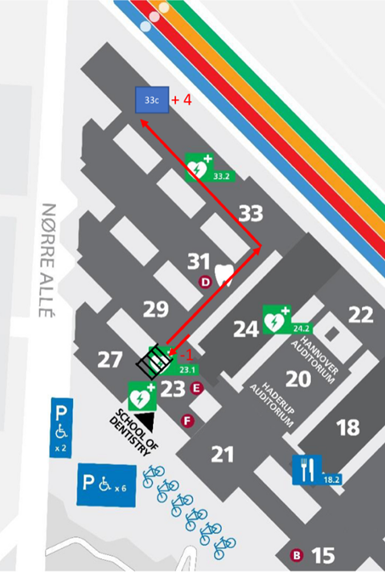

Center for Health Data Science (HeaDS)
The mission of the Center is to strengthen health data science within the Faculty:
Active and visible hub for Health Data Science
Providing data science support for researchers at SUND
Courses, workshops and training environments to improve data science skills
Support a network of researchers and educators
https://heads.ku.dk

Slide 4

CENTER STRUCTURE
Generative modelling
Representation learning
Data Science in Epidemiology
HPC environments
Public & synthetic data
Courses and training
SANDBOX
RESEARCH GROUPS
SUND DATALAB
Courses, Consulting,
Commissions, Supervision

Slide 5
About this course

Slide 6

About this course
Originally developed at the Center for Protein Research (CPR) by:
Alberto Santos Delgardo (University of Oxford)
Henry Webel (NNF CPR)
Annelaura Bach Nielsen (NNF CPR)
Rita Colaço (PRI)
We say thank you for the course material which we have adapted.

Slide 7





About this course
Your teachers:
Thilde Terkelsen (HeaDS)
Rita Colaço (PRI)
Valentina Sora (HeaDS)
Henrike Zschach (HeaDS)
Inigo Prada Luengo (HeaDS)

Slide 8
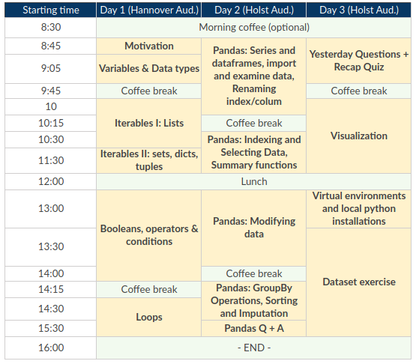
About this course

Slide 9
Python

Slide 10
Why Python?
Python is a great programming language for both beginners and advanced programmers:
Easy to grasp, close to natural language
Many learning resources available
Large community (i.e. stackoverflow for questions)
Libraries
Can do very advanced things like neural networks

Slide 11
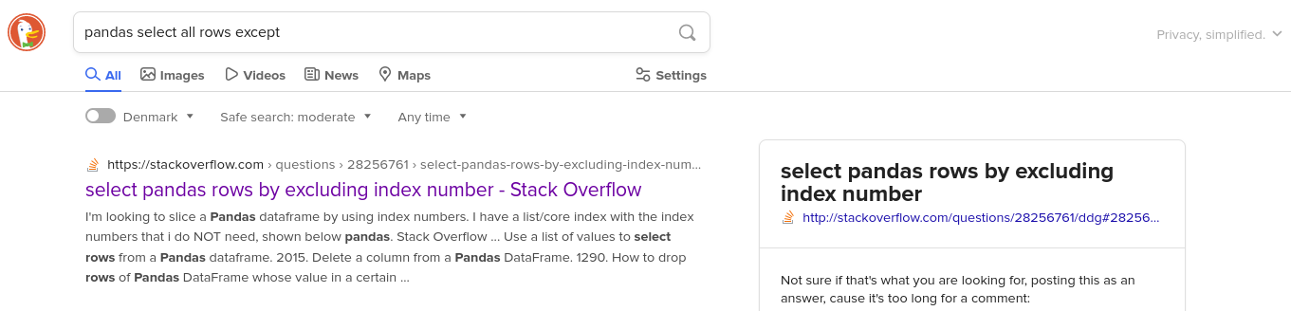
Where to get help
Online communities such as stackoverflow are an important tool in programming.
You can also ask chatGPT, but remember to verify the answer!

Slide 12
Python environments

Slide 13

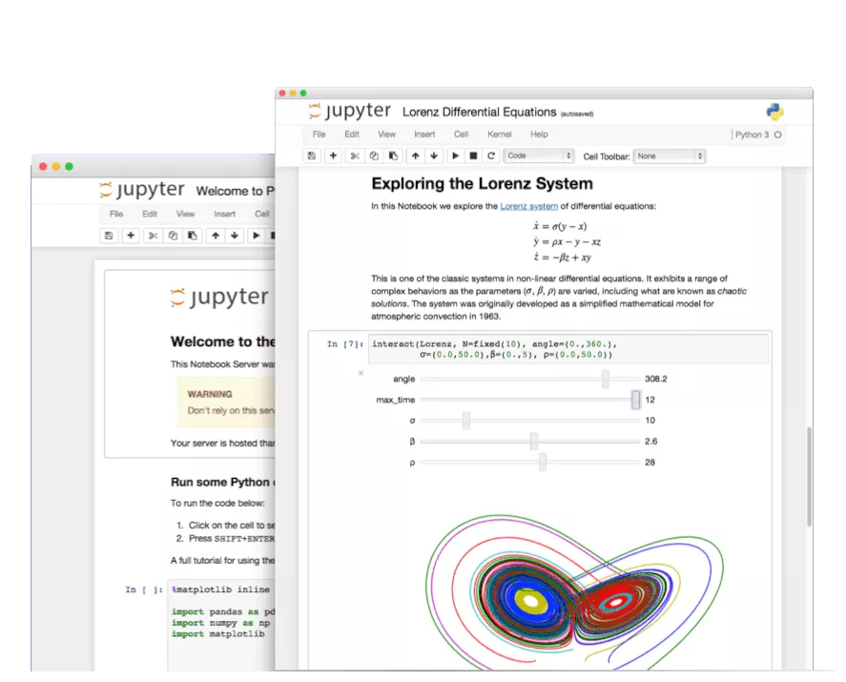
Jupyter notebook
The Jupyter Notebook is an open-source application to create and share documents that contain code, equations, visualizations and text (markdown).
Browser-based development environment for creating, running and sharing Python code
Combine code with text and output
Runs from your local installation. I.e., you need Python and the libraries you want to use installed on your computer

Slide 14

Google Colab
Google Colab is a Jupyter Notebook hosted on Google’s servers, not your own machine. It still runs in your browser.
tool to write, execute and share Python code through the browser
requires no setup to use and provides free access to computing resources on Google’s servers including GPUs
is connected to a Google account and data and notebooks can be accessed through Google Drive.
We’ll use Colab during the course.

Slide 15
Using libraries/packages

Slide 16
Libraries
Python has many libraries, also called packages, that other programmers have developed. Find and use them!
Well-maintained libraries generally are:
Tested
Optimized
Documented
There is no need to reinvent the wheel. During this course we will use:
Pandas (all the data analysis!)
Math (basic math)
Plotly express (visualization)

Slide 17
Libraries
If you are running Python from a local installation, you need to have libraries installed before you can use them.
On Google Colab you can generally just import, they are already installed.
Import the math library:
import math
Now I can use functions from that library, i.e. calculating the logarithm or square root:
math.log(3)
math.sqrt(4)

Slide 18
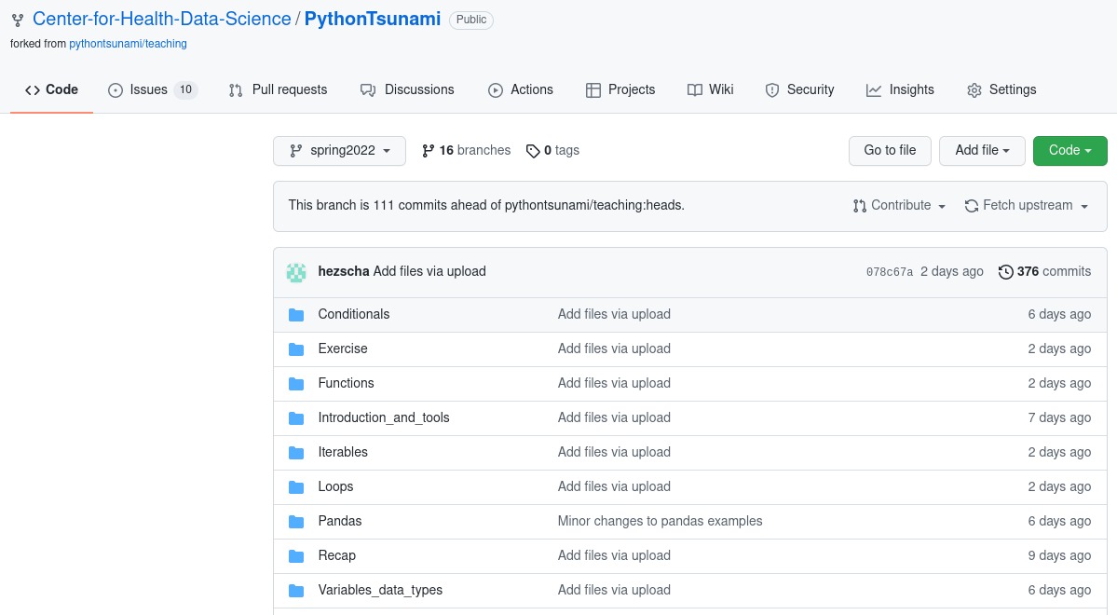
Course material
You can find the course material here:
https://github.com/Center-for-Health-Data-Science/PythonTsunami

Slide 19
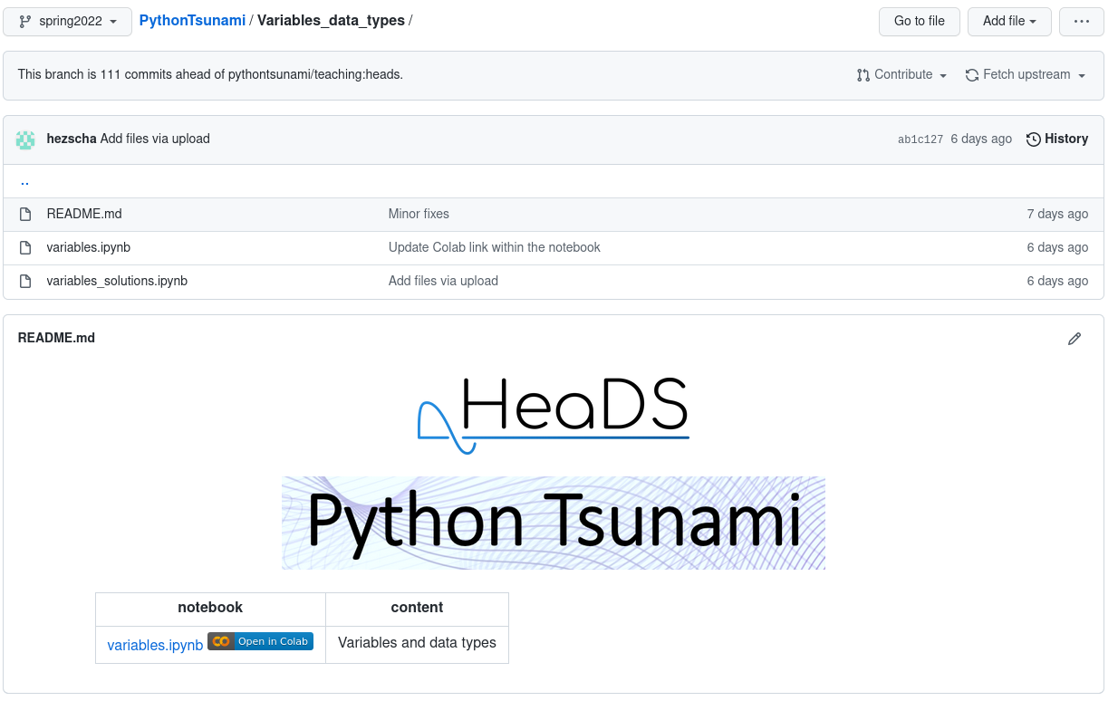
Course material

Slide 20
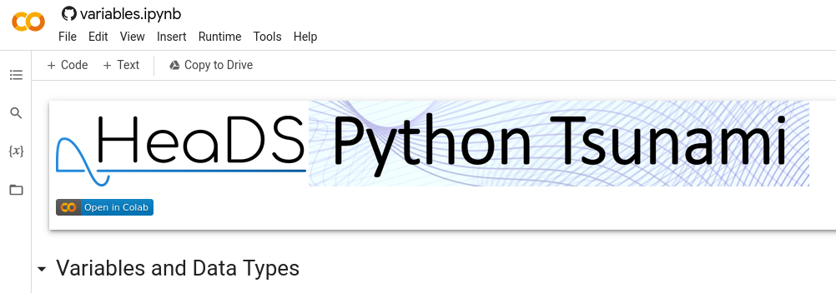
Course material
Remember to save a copy to your own google drive so you can save your notes and exercises!

Slide 21
Short Introduction
Take the next 5 mins to introduce yourself at your table:
Name
Position
Unit
What you do (very briefly!)

